Slide 1

MEET THE TEACHER
September 2026
Year 4

Slide 2


Brindishe Federation Priorities 26/27

Slide 3
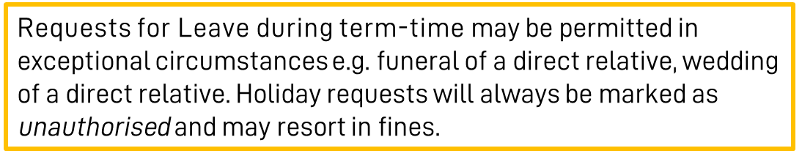
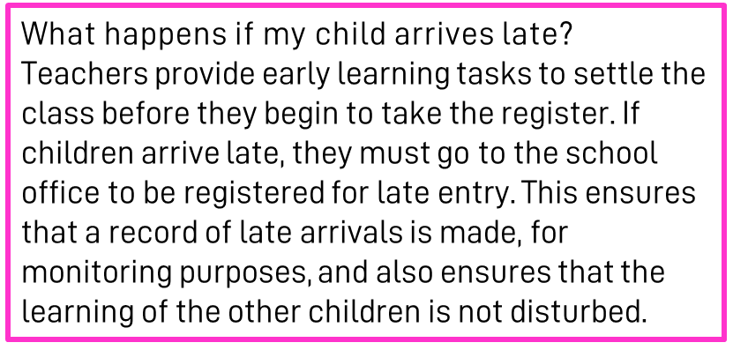
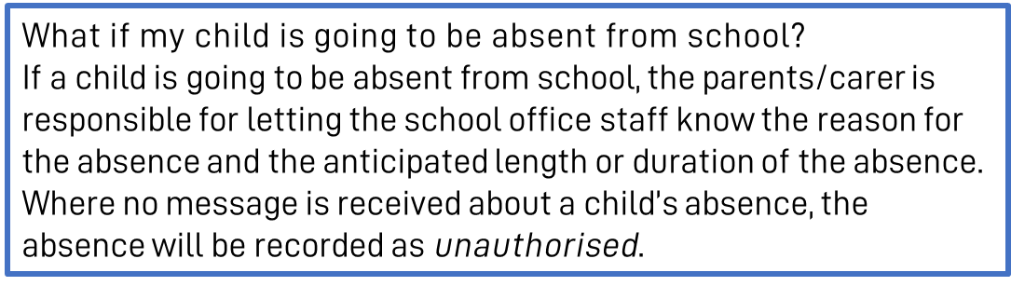
Attendance & Punctuality
At Brindishe Schools we believe that good attendance and punctuality are essential. Research shows that children who attend school regularly do better at school and make better progress.
Brindishe Manor
Start Time - Gates Open 8.35am/Gates Close 8.45am
Children are expected to be in school by 8.45am. Children arriving after 8.45am will be marked at ‘late’
Finish Time - School Ends 3.15pm

Slide 4
Attendance & Punctuality
Planned Absences
Please ensure that you inform the office of any planned absences in advance, either by email or telephone e.g. Eid, Secondary School visits/tests.
Last Minute Collection Arrangements
Please telephone the school office before 2pm if collection arrangements for your child have changed for that day.
Pick-Up Passwords
If another adult is collecting your child, they will be required to provide a ‘pick-up’ password before they can take your child home. Please ensure you pass this onto the school office when you inform them of alternative collection arrangements.

Slide 5
Communication Channels
Absent Reporting
To report your child absent please call or email before 8.30am. Please call the school on each day of your child’s absence.
Brindishe Manor - 0208 852 - info-BM@brindisheschools.org
Message for Class Teacher or a member of the Senior Leadership Team
Email info-BM@brindisheschools.org – please mark ‘For Attention Of …’ followed by the name of the member of staff e.g. FAO Mr Jones.
Extended Services – Breakfast and Tea Club
Clare Dawson can be contacted at extendedservices-BM@brindisheschools.org
Telephone on: 020 8852 0852
General Enquiries
0208 852 7245 – info-BM@brindisheschools.org
Our preferred method of communication is via email if you cannot find the answer on the school website. Emails will be responded to within 48 hours so if it is an emergency, please call the school directly.
Nourish and School Meals
Clare Doran - schoolmeals@brindisheschools.org
M: 07943 041790

Slide 6


Arbor
What can you do on the Arbor App?
Add and amend information
See school notices
Update child’s information
Update your information
See your child’s lessons
See your child’s attendance
Retrieve an attendance summary for week, term and/or the year
Book a parent/carer consultation
Sign your child up for clubs, trip, visitors and music
Pay for trips and clubs (where needed)
See account balances

Slide 7
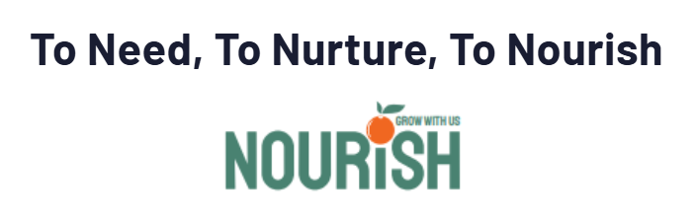
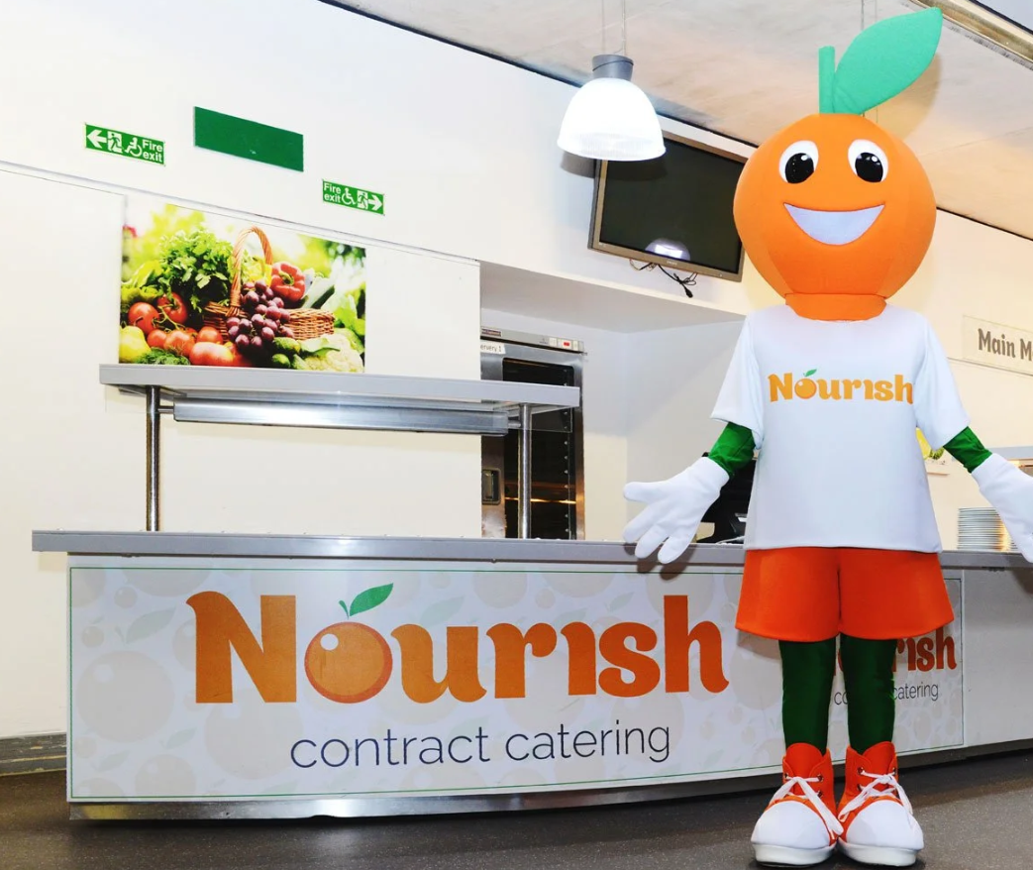
Nourish (school meals) and FSM
Nourish is a friendly family-led school caterer with bags of initiative and a love of good food. They believe every child needs a satisfying meal at lunchtime, fuelling them for the afternoon ahead. Nurturing the importance of a healthy and balanced diet, they provide a nutritious meal every day to nourish from within.
Each day the children will have a choice of:
Three main dishes
A pudding OR a choice of either cheese/biscuits or yoghurt
Freshly baked bread
Fresh fruit
Nine salad choices each day from the salad bar
Milk and water
Cost per day: Free under the current Mayor of London’s Scheme
Autumn Term Menus can be found on the school website.

Slide 8
Key Dates
Term Dates: 2026–2027
Autumn Term
Thursday 3rd September 2026 to Friday 23 October 2026
Half-term: Monday 26 October 2026 to Friday 30 October 2026
Monday 2 November 2026 to Friday 18 December 2026
Spring Term
Tuesday 5 January 2027 to Friday 12 February 2027
Half-term: Monday 15 February 2027 to Friday 19 February 2027
Monday 22 February 2027 to Wednesday 24 March 2027
Summer Term
Monday 12 April 2027 to Friday 28 May 2027
(the early May bank holiday will be taken on 3 May)
Half-term: Monday 31 May 2027 to Friday 4 June 2027
Monday 7 June 2027 to Wednesday 21 July 2027
INSET DAYS
Wednesday 2 September 2026
Friday 27 November 2026
Monday 4 January 2027
Thursday 25 March 2027
Thursday 22 July 2027
We will endeavour as much as practically reasonable, to provide you with dates well in advance. Please see our ‘Key Dates for Parents/Carers’ document on Weduc. Class teachers will give you at least 2 weeks' notice of a planned Educational Visit.

Slide 9
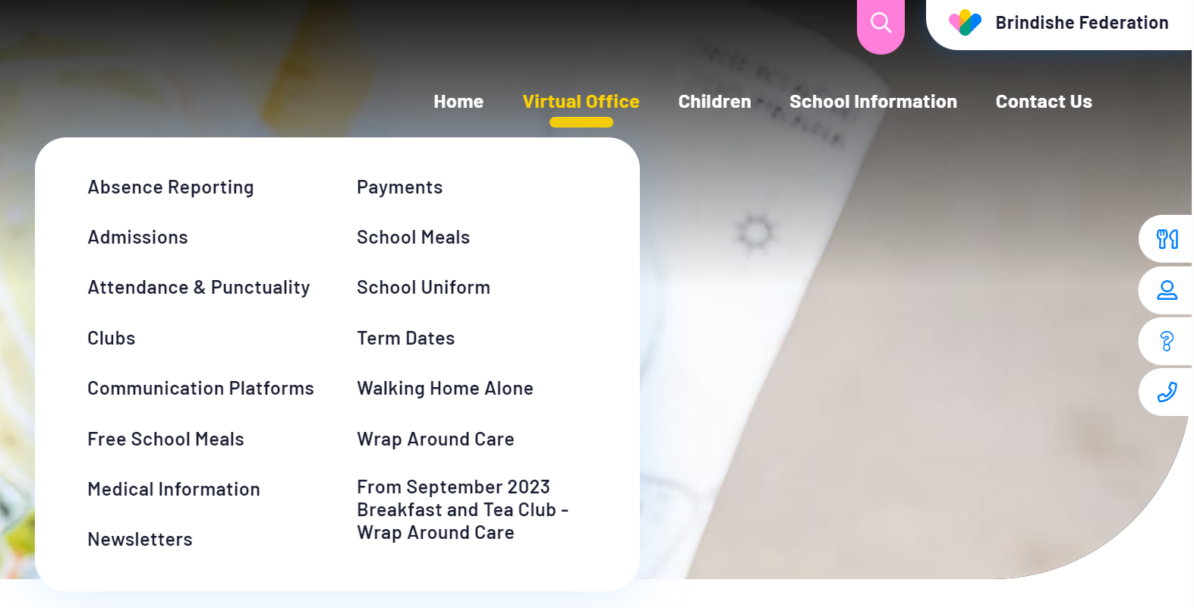
Website
The Brindishe Federation and school website provides all key information needed for parents/carers.
The website includes:
School Policies, including Attendance, Admissions, Complaints and RSHE
Meet our Governing Body
Nourish Termly Menus
The Brindishe Curriculum and Year Group Overviews
Data and Performance Measures
External Reviews – Ofsted
Typical School Day
How to support your child at home
Clubs and Wrap Around Care
Weekly federation and school newsletters
Reading
Equalities & Diversity
PTAs
….. And much more.
The website also provides a virtual office function – please visit the virtual office for all your daily enquiries and needs.

Slide 10
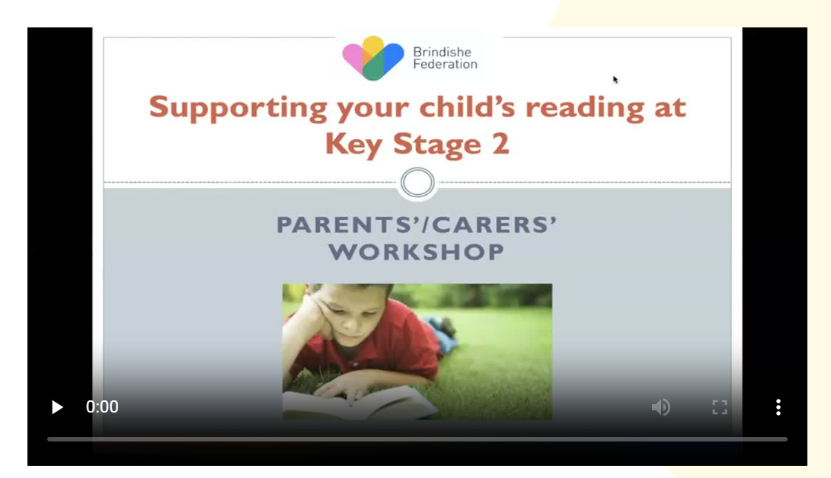
Website – Class Pages
Curriculum Overviews
Videos to support learning
Core Subject Specific Information (Maths and English)
Spelling Lists
Teaching Teams
Newsletters

Slide 11
Year 4 Multiplication Tables Check
The purpose of the check is to determine whether your child can fluently recall their times tables up to 12, which is essential for future success in mathematics. It will also help us to identify if your child may need additional support.
What is the multiplication tables check?
It is an on-screen check consisting of 25 times table questions. Your child will be able to answer 3 practice questions before taking the actual check. They will then have 6 seconds to answer each question. On average, the check should take no longer than 5 minutes to complete.
You do not need to do anything additional to prepare your child for the check. As part of usual practice, teachers may ask you to practise times tables with your child.
We will have unlimited access to a ‘try it out’ area from April. We can use this to make sure pupils have the necessary support required to access the check. This includes opportunities for pupils to familiarise themselves with the check application and try out any access arrangements that may be required.
How will the results be used?
Schools will have access to all their pupils’ results, allowing those pupils who need additional support to be identified. We will share your child’s score with you in the end of year report. There is no pass mark for the check.

Slide 12
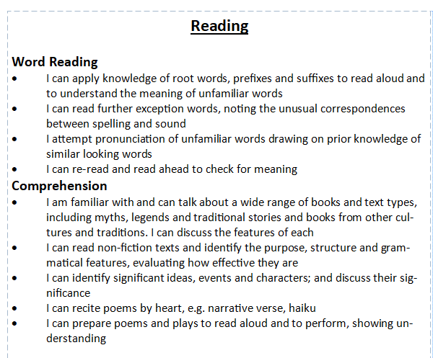

End of Year Expectations
Overwhelming response and feedback from parent/carer survey indicated a want and need for clearer end of year expectations for your children.
Today, all families will receive the ‘End of Year Expectations’ booklet. We hope this will support you in knowing where how your child is progressing and how to support at home.

Slide 13
How can school and home collaborate and work together?
Join our PSFA – Brindishe Friends Group – Over £30,000 raised last year which contributed to the hall acoustics and will fund the OPAL Playground initiative.
Trips and Visitors can be paid for online via Arbor – without your contributions trips and enrichment opportunities cannot go ahead.
We strive to communicate with you as much as possible and in a timely manner. Please remember that communication channels are via info-BM@brindisheschools.org.
Engage with Arbor and the school website as much as possible, especially when paying for clubs, trips and music.
We strive to communicate with you as much as possible and in a timely manner. Please remember that communication channels are via info-BM@brindisheschools.org.

Slide 14
MEET THE YEAR GROUP TEAM

Slide 15
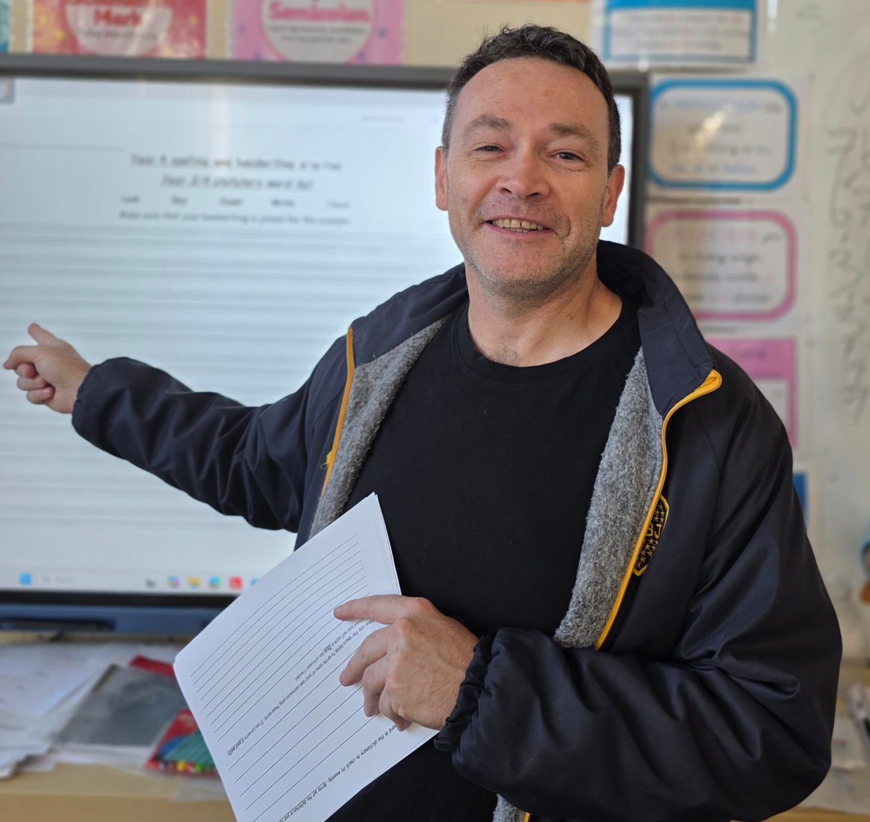
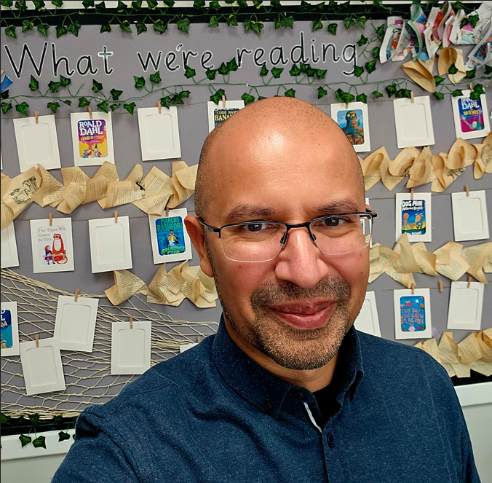
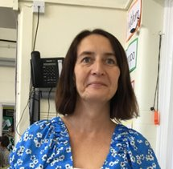
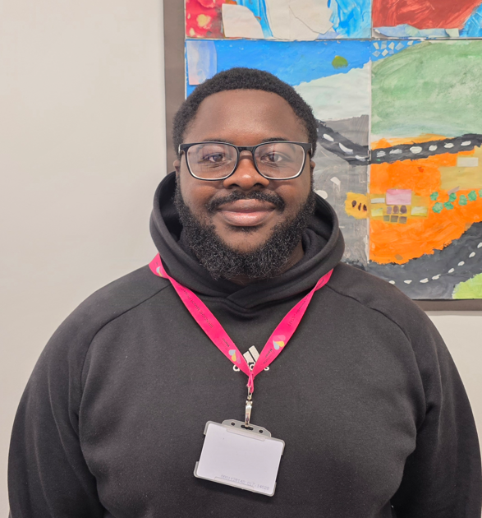
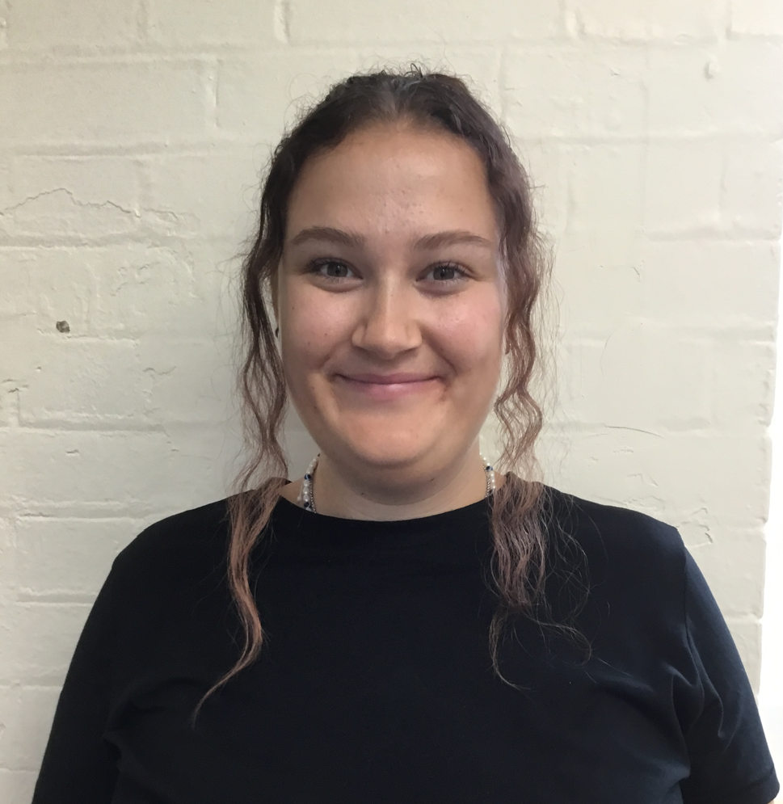
Meet the Team
Attenborough
Thunberg
Mr Jones
Mr Dhuru
Mrs Ayeni
Mr Odusote
Miss Ashman

Slide 16
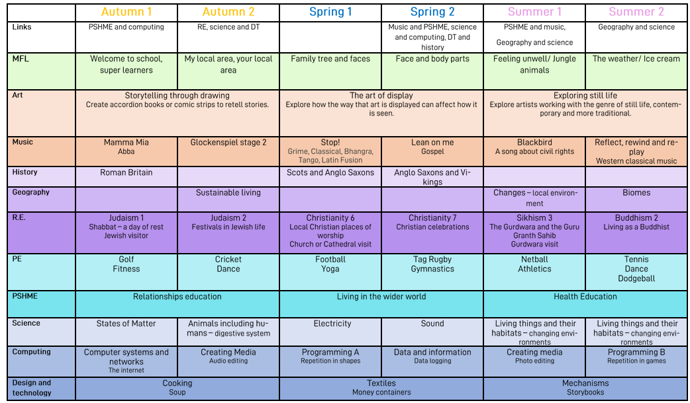
Yearly Overview

Slide 17
Autumn Term Overview
Literacy
We will begin the year by analysing and writing a cinquain poems. Following this, the children will explore descriptive and emotive vocabulary to produce an engaging narrative full of suspense based on our class book Escape from Pompeii by Christina Balit. Their focus will be the setting and character description.
Maths - We will begin with place value - we will be reviewing place value of three digits numbers before moving onto numbers up to 10,000. We will complete a unit on addition and subtraction of four-digit numbers using mental strategies along with the formal written method, including exchanges. As well as this, we will be consolidating previous times table learning (5, 10, 2, 4 and 8). Please practise these at home when you get the chance.
Science – We will be learning about states of matter. The children will learn to identify solids, liquids and gases, they will plan and carry out fair tests and record their findings in a variety of ways.
Art- Our focus is storytelling through drawing. We will be inspired by the poem of Jabberwocky and explore how images tell tales.
History – We will be studying our topic of Invaders and Settlers starting with the Romans. We will explore how the Roman Empire expanded into Britain. We will discuss the power of the Roman army. How Rome impacted on daily life in Britain.
RE – Our topic is Judaism – Shabbat. We will be looking for answers to questions such as: Why is Shabbat important to Jews?
Computing – The Internet is the focus of study. Children will explore how the internet lets us view the World Wide Web and recognise that the World Wide Web is part of the internet which contains websites and web pages
Music – We will be completing a unit based around Mamma Mia by Abba. Children will be listening and appraising this song as well as others by Abba. They will sing, play the glockenspiel and perform to each other.
P.E. – This half term we will be playing tri-golf and personal fitness.
Spanish: We will be revising old vocabulary and learning new vocabulary to describe our classroom and objects in it.
PHSME: This half-term our focus is relationships. We will be looking at families and friendships as well as what makes a safe relationship as opposed to an unhealthy relationship.

Slide 18
Planned enrichment opportunities, trips and visits.
Autumn:
Architecture Workshop (Building a huge Roman Villa) – DT..History..Maths
Hayward Gallery - Art
Crofton Roman Villa - History
Spring:
Bromley Reform Synagogue – Judaism – R.E.
Swimming over this term. – P.E.
Juniper Hall – 3 day residential
Summer:
Sports Day
Naval College Greenwich – Pattern and Shape – Maths
British Museum

Slide 19
PE Expectations and dates
On PE days, your child will be expected to wear named clothing suitable for a range of different sports and/or physical activity.
This would include the correct PE shoes, a tracksuit or jogging bottoms/shorts and a T-shirt.
PE Days
Attenborough: Tuesday (indoor) and Friday (outdoor)
Thunberg: Wednesday (indoor) and Thursday (outdoor)

Slide 20
Home-Learning Expectations
Weekly Maths
Weekly English
Weekly reading activity
Alternate wider curriculum activity
Times Tables – ‘Hit The Button’

Slide 21
How parents/carers can support at home
Daily Reading
Encourage your child to read for 15-20 minutes every day and discuss what they have read.
Ask questions about characters, vocabulary, and events to develop comprehension skills.
Engagement with 'Me Books'
Access and read 'Me Books' regularly at home to build fluency and confidence.
Talk about favourite parts of the text and explore new vocabulary together.
Supporting Mathematics
Practise multiplication tables regularly to improve recall and confidence.
Use everyday activities such as shopping, cooking, and telling the time to apply maths skills.
Supporting Writing
Encourage writing for a range of purposes, including stories, letters, and diaries.
Support accurate spelling, punctuation, and grammar through everyday conversations and activities.
Promoting Independence
Encourage your child to complete homework and organise belongings independently.
Maintain a regular routine and a quiet space for learning at home.
Talking and Learning Together
Discuss books, current events, and everyday experiences to broaden knowledge and vocabulary.
Encourage curiosity by exploring interests and learning opportunities together.

Slide 22
How to contact us
Class teachers are always available for brief informal chats on the playground at the end of the day.
For more formal and longer meetings or phone calls, please email info-BM@brindisheschools.org and mark the email ‘For the Attention Of….’ followed by the class teachers name e.g. FAO Mr Jones.

