Slide 1

MEET THE TEACHER
September 2026
Year 3

Slide 2


Brindishe Federation Priorities 26/27

Slide 3
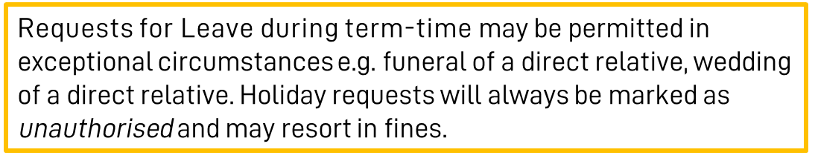
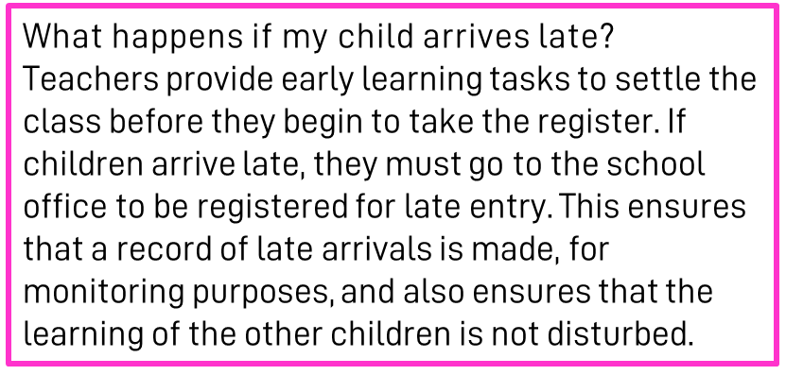
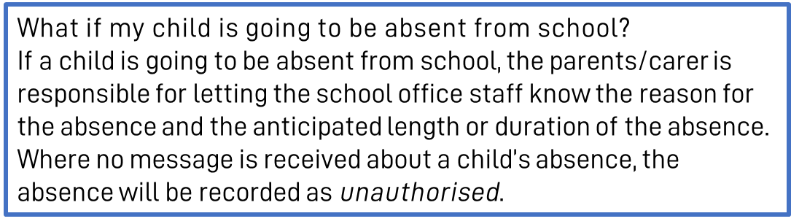
Attendance & Punctuality
At Brindishe Schools we believe that good attendance and punctuality are essential. Research shows that children who attend school regularly do better at school and make better progress.
Brindishe Manor
Start Time - Gates Open 8.35am/Gates Close 8.45am
Children are expected to be in school by 8.45am. Children arriving after 8.45am will be marked at ‘late’
Finish Time - School Ends 3.15pm

Slide 4
Attendance & Punctuality
Planned Absences
Please ensure that you inform the office of any planned absences in advance, either by email or telephone e.g. Eid, Secondary School visits/tests.
Last Minute Collection Arrangements
Please telephone the school office before 2pm if collection arrangements for your child have changed for that day.
Pick-Up Passwords
If another adult is collecting your child, they will be required to provide a ‘pick-up’ password before they can take your child home. Please ensure you pass this onto the school office when you inform them of alternative collection arrangements.

Slide 5
Communication Channels
Absent Reporting
To report your child absent please call or email before 8.30am. Please call the school on each day of your child’s absence.
Brindishe Manor - 0208 852 0852 - info-BM@brindisheschools.org
Message for Class Teacher or a member of the Senior Leadership Team
Email info-BM@brindisheschools.org – please mark ‘For Attention Of …’ followed by the name of the member of staff e.g. FAO Miss Matthews.
Extended Services – Breakfast and Tea Club
Alicia Graham (Interim Extended Services Manager) can be contacted at extendedservices-BM@brindisheschools.org
Telephone on: 020 8852 7245
General Enquiries
0208 852 7245 – info-BM@brindisheschools.org
Our preferred method of communication is via email if you cannot find the answer on the school website. Emails will be responded to within 48 hours so if it is an emergency, please call the school directly.
Nourish and School Meals
Clare Doran - schoolmeals@brindisheschools.org
M: 07943 041790

Slide 6


Arbor
What can you do on the Arbor App?
Add and amend information
See school notices
Update child’s information
Update your information
See your child’s lessons
See your child’s attendance
Retrieve an attendance summary for week, term and/or the year
Book a parent/carer consultation
Sign your child up for clubs, trip, visitors and music
Pay for trips and clubs (where needed)
See account balances

Slide 7


Nourish (school meals) and FSM
Nourish is a friendly family-led school caterer with bags of initiative and a love of good food. They believe every child needs a satisfying meal at lunchtime, fuelling them for the afternoon ahead. Nurturing the importance of a healthy and balanced diet, they provide a nutritious meal every day to nourish from within.
Each day the children will have a choice of:
Three main dishes
A pudding OR a choice of either cheese/biscuits or yoghurt
Freshly baked bread
Fresh fruit
Nine salad choices each day from the salad bar
Milk and water
Cost per day: Free under the current Mayor of London’s Scheme
Autumn Term Menus can be found on the school website.

Slide 8
Key Dates
Term Dates: 2026–2027
Autumn Term
Thursday 3rd September 2026 to Friday 23 October 2026
Half-term: Monday 26 October 2026 to Friday 30 October 2026
Monday 2 November 2026 to Friday 18 December 2026
Spring Term
Tuesday 5 January 2027 to Friday 12 February 2027
Half-term: Monday 15 February 2027 to Friday 19 February 2027
Monday 22 February 2027 to Wednesday 24 March 2027
Summer Term
Monday 12 April 2027 to Friday 28 May 2027
(the early May bank holiday will be taken on 3 May)
Half-term: Monday 31 May 2027 to Friday 4 June 2027
Monday 7 June 2027 to Wednesday 21 July 2027
INSET DAYS
Wednesday 2 September 2026
Friday 27 November 2026
Monday 4 January 2027
Thursday 25 March 2027
Thursday 22 July 2027
We will endeavour as much as practically reasonable, to provide you with dates well in advance. Please see our ‘Key Dates for Parents/Carers’ document on Weduc. Class teachers will give you at least 2 weeks' notice of a planned Educational Visit.

Slide 9
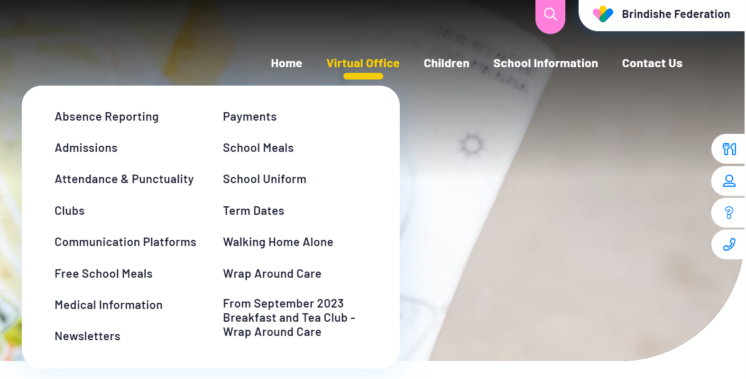
Website
The Brindishe Federation and school website provides all key information needed for parents/carers.
The website includes:
School Policies, including Attendance, Admissions, Complaints and RSHE
Meet our Governing Body
Nourish Termly Menus
The Brindishe Curriculum and Year Group Overviews
Data and Performance Measures
External Reviews – Ofsted
Typical School Day
How to support your child at home
Clubs and Wrap Around Care
Weekly federation and school newsletters
Reading
Equalities & Diversity
PTAs
….. And much more.
The website also provides a virtual office function – please visit the virtual office for all your daily enquiries and needs.

Slide 10

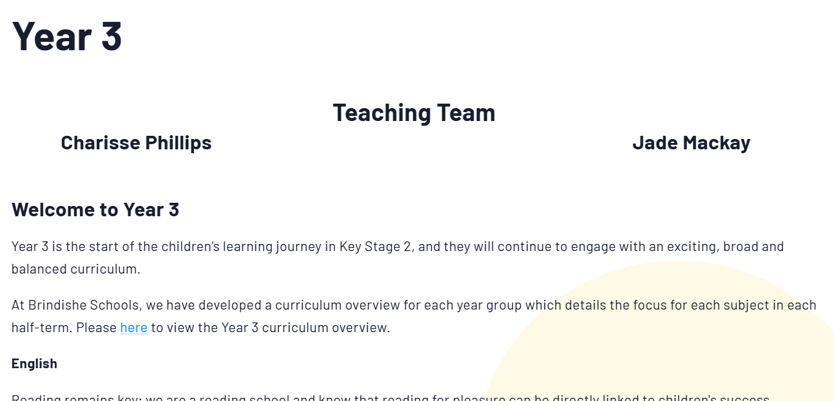
Website – Class Pages
Curriculum Overviews
Videos to support learning
Core Subject Specific Information (Maths and English)
Spelling Lists
Teaching Teams
Newsletters

Slide 11
How can school and home collaborate and work together?
Join our PSFA – Parent, Staff Families Association– They work so hard and contribute so much to the school raising thousands for the children to enrich their school experience further.
Trips and Visitors can be paid for online via Arbor – without your contributions trips and enrichment opportunities cannot go ahead.
We strive to communicate with you as much as possible and in a timely manner. Please remember that communication channels are via info-BM@brindisheschools.org.
Engage with Arbor and the school website as much as possible, especially when paying for clubs, trips and music.
We strive to communicate with you as much as possible and in a timely manner. Please remember that communication channels are via info-BM@brindisheschools.org.

Slide 12
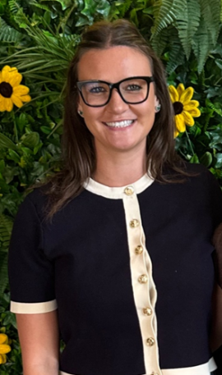
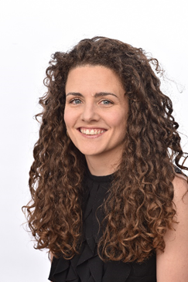
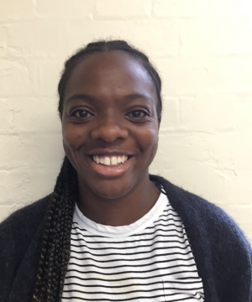
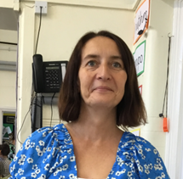
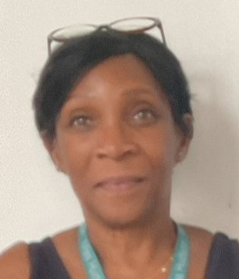
Meet the Team
Teachers:
Pankhurst Class Yousafzai Class
Miss Mackay Mrs Phillips and Ms Dougan
Teaching Assistant: Mr Bird and Mr Wafflart
PPA cover: Mrs Ayeni PPA cover: Ms Hudson

Slide 13
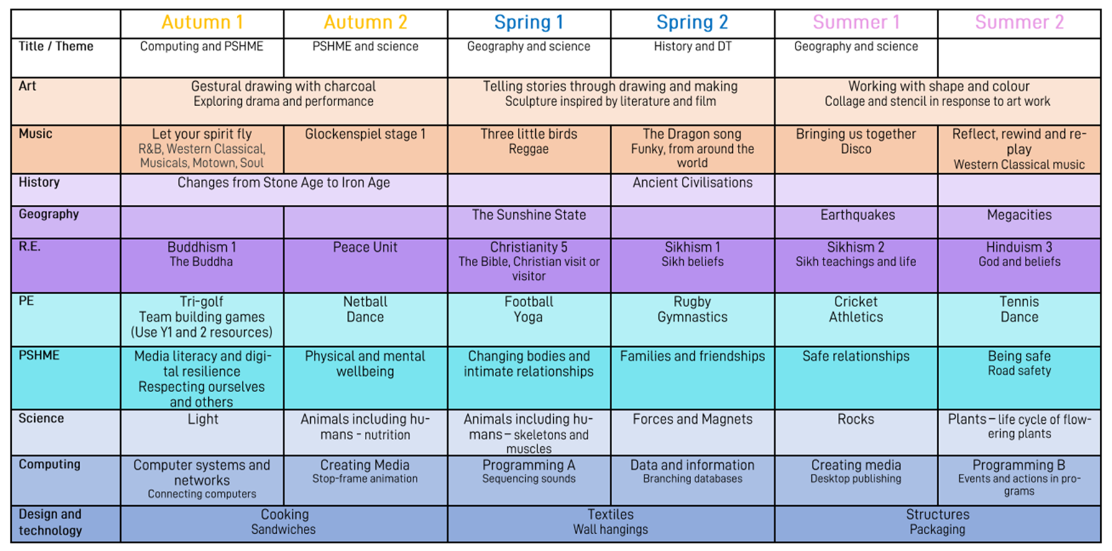
Yearly Overview

Slide 14
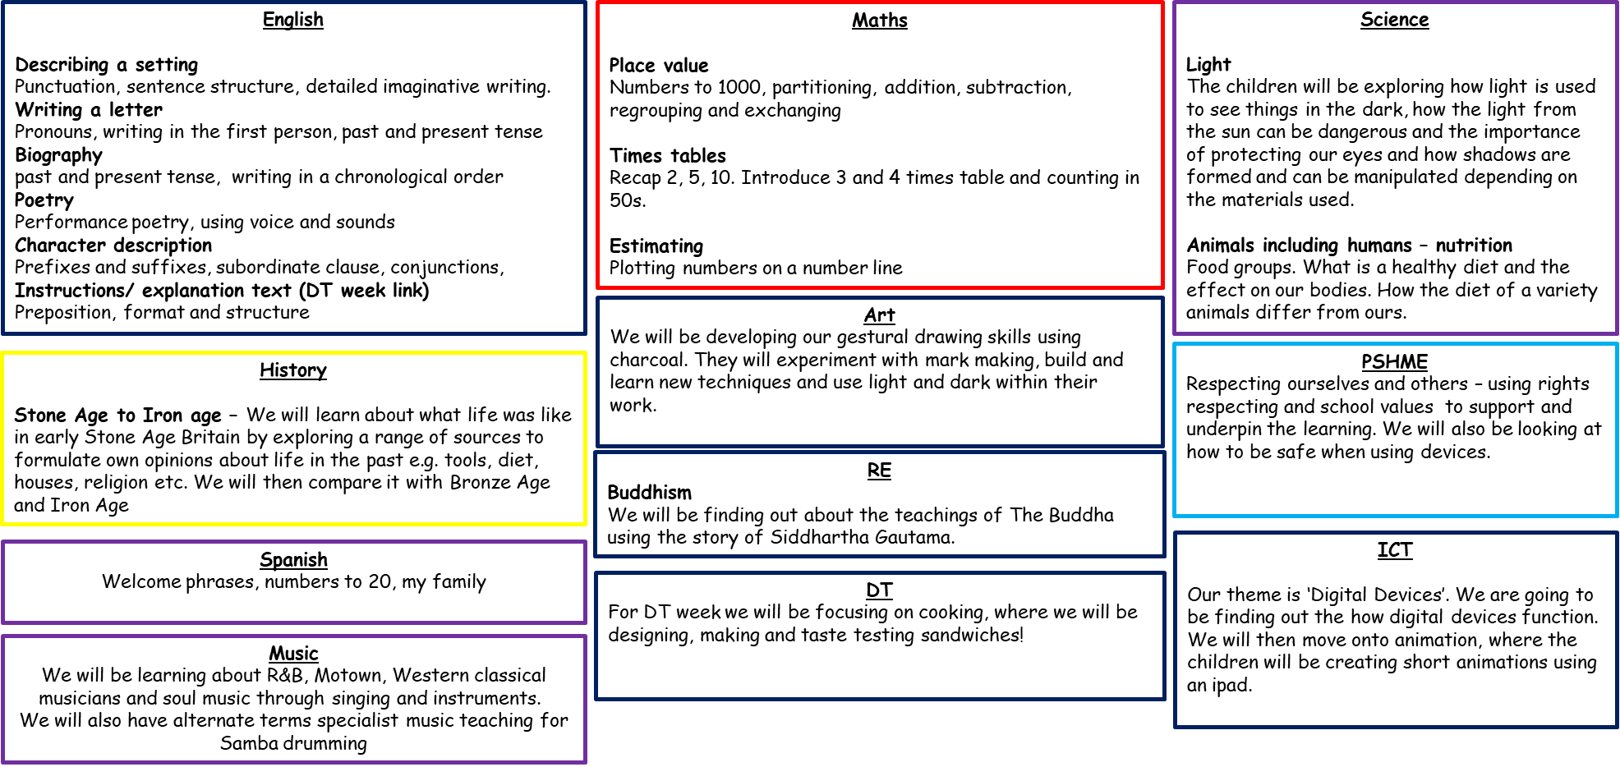
Autumn Term Overview

Slide 15
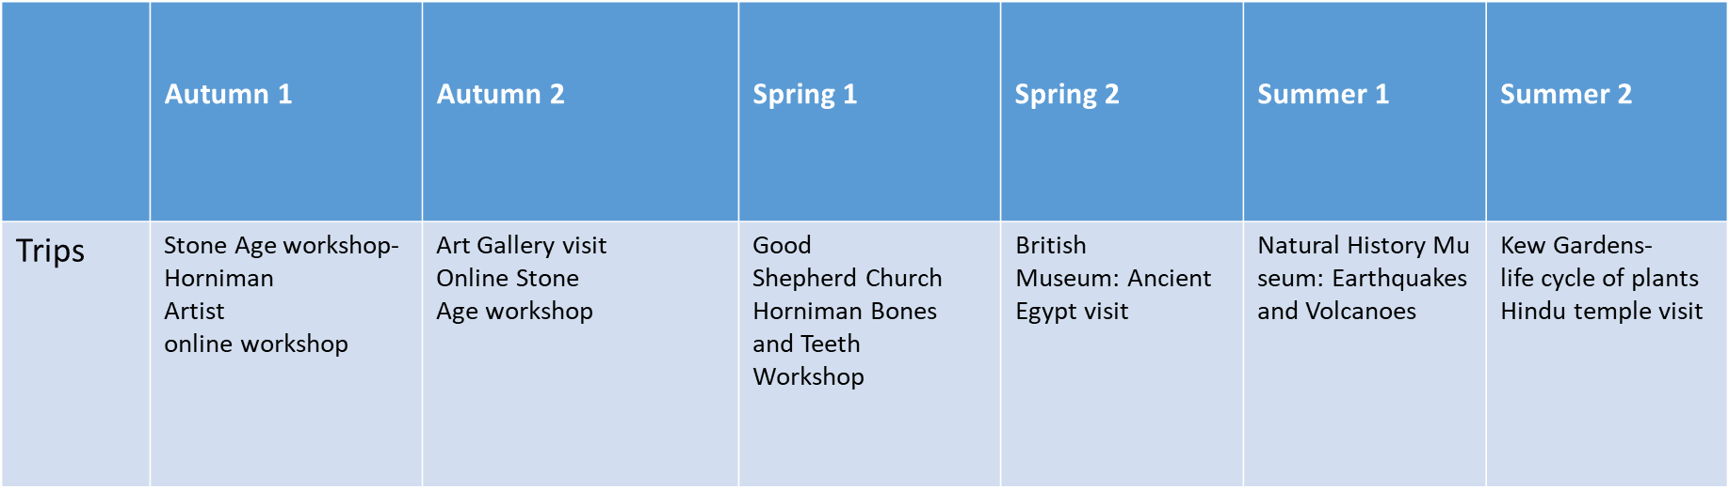
Planned enrichment opportunities, trips and visits.
Parents and Carers will be informed of the visit on Weduc and there will be a section which asks for help. If there are more offers of help than are needed, names will be drawn out of a hat. Over the year, care will be taken to make sure every parent/carer has a turn if they can help. The office will let parents/carers know who has been chosen to go on the trip or if you are not needed.

Slide 16
PE Expectations and dates
PE kit: t-shirt, sweatshirt, leggings/shorts/ tracksuit bottoms, trainers
Jewellery: stud earrings only, no rings/bangles, hoop earrings or necklaces (unless worn for religious reasons – agreed by Miss Porter/Ms Dougan)
Pankhurst Yousafzai
Tuesday (outdoor) Monday (outdoor)
Friday (indoor) Tuesday (indoor)

Slide 17
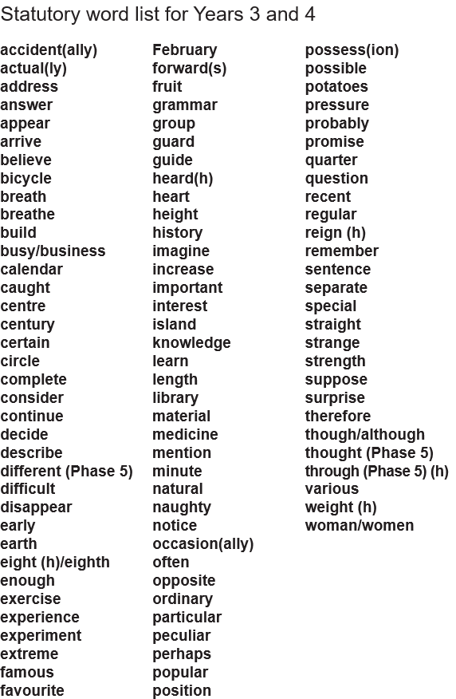
Home-Learning Expectations
The online home learning will include:
Weekly English
Weekly Maths
Weekly Bug Club reading
Half-termly project linked to termly theme
We will share the spelling patterns we are looking at for the half term and the Y3/4 spelling list so you can practise at home

Slide 18
How parents/carers can support at home
Reading daily with your children and talking about books with your children. If your child is continuing with the banded books please use the reading records as well. There will be books allocated on bug club as well as books from the class library.
Spelling – we will share the half term spelling patterns so you can practise them with your children as well as the Y3/4 spelling list from the national curriculum.
Number bonds to 20 – ensuring the children are fluent and fast in recall of these: https://www.topmarks.co.uk/maths-games/hit-the-button
Timetables practice and games
Using Sumdog – fun games with questions personally matched to the children's stage in learning
History/ Science/ Geography research, presentations

Slide 19
How to contact us
Class teachers are always available for brief informal chats on the playground at the end of the day.
For more formal and longer meetings or phone calls, please email info-BM@brindisheschools.org and mark the email ‘For the Attention Of….’ followed by the class teachers name e.g. FAO Mrs Phillips

